Slide 1





STARTUP INVESTMENTS
Predicting the success of the startup companies using Machine Learning
GROUP 6
Vineeth Penugonda
Sai Rachana Bandi

Slide 2



INTRODUCTION

Slide 3
INTRODUCTION
STARTUPS
traditionally defined as a newly established private company (< 5 - 10 years old), that is designed to scale very quickly.
seek additional funding from venture capitalists and angel investors as they build out their businesses.
FUNDING
Companies can receive many different types of funding – Angel, Pre-Seed, Seed, Venture, Round A, Round B, Round C.

Slide 4
INTRODUCTION
DATA
CrunchBase
World’s largest structured database for startups.
SUCCESS OF A STARTUP
IPO (Public Initial Offering) by going to a public stock market.
Acquired or merged (M&A) with another company.

Slide 5








OBJECTIVE
Previous studies tend to focus primarily on managerial features
Overview the impact of financial features related with funding.
We predict the success of a startup company based on market, region and financial variables.
This prediction will help investors to get an idea whether investing in a startup will be successful or not?

Slide 6
DATA PREPROCESSING

Slide 7
59
643
USA
17,784
1990 - 2014
Variables
Markets
Rows
STARTUPS
YEARS

Slide 8
DATA PREPROCESSING
On initial observation, the dataset downloaded from Kaggle had a lot of missing data. So, we removed rows which had missing data in one or more columns.
A lot of rows had commas and trailing spaces which we had to trim down.
We didn’t require few columns like homepage URL of the startup company, permalink - permanent link in the crunchbase and country codes.

Slide 9
DATA PREPROCESSING
We split columns which had dates in the format (YY/MM/DD).
There are more than 32 markets, regions and states. We binary encoded the values in market, region, state_code. Then, digits from that binary string are split into separate columns.
This is useful for machine learning.
Better encoding of categorical data can mean better model performance.

Slide 10
DATA PREPROCESSING
We converted all the categorical variables to factors. We also converted the data types from numericals to boolean for the binary encoded columns.
In the end, we got a cleansed dataset which was stored as an RDS file.

Slide 11
FACTORS THAT CONTRIBUTE TO THE SUCCESS OF STARTUPS
More number of funding rounds contributes to the success of a startup.
Day and Year in which the startup was founded.
Example: A startup founded during the dot-com boom.
More Seed amount.
Seed rounds are among the first rounds of funding a company will receive, generally while the company is young and working to gain traction
More Venture Capital.
Venture funding refers to an investment that comes from a venture capital firm and describes Series A, Series B, and later rounds.

Slide 12
FACTORS THAT CONTRIBUTE TO THE SUCCESS OF STARTUPS
More funding in the post-IPO equity round.
A post-IPO equity round takes place when firms invest in a company after the company has already gone public.
More funding in Round A, Round B, Round C funding rounds.
$1M–$30M

Slide 13
DATA VISUALIZATION

Slide 14
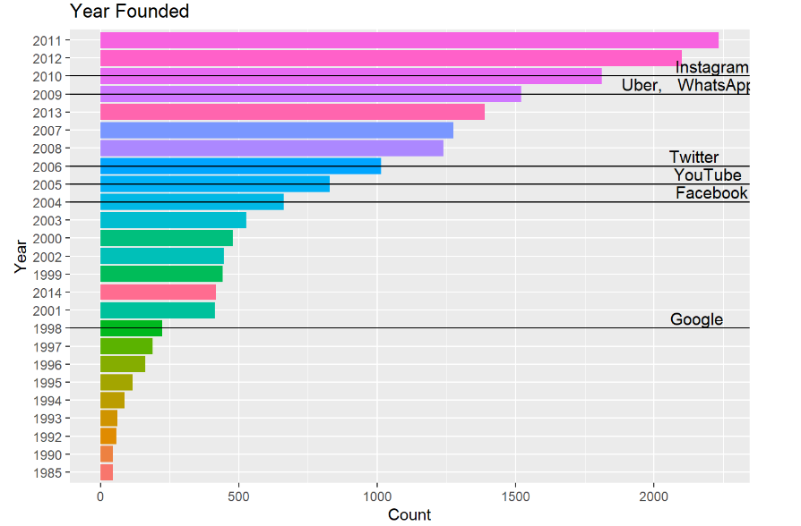

Slide 15
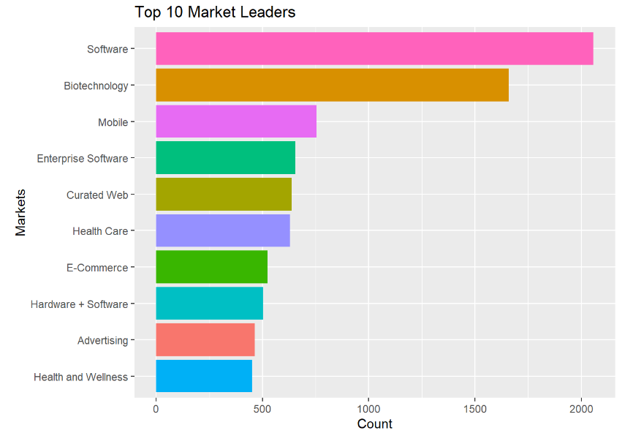

Slide 16
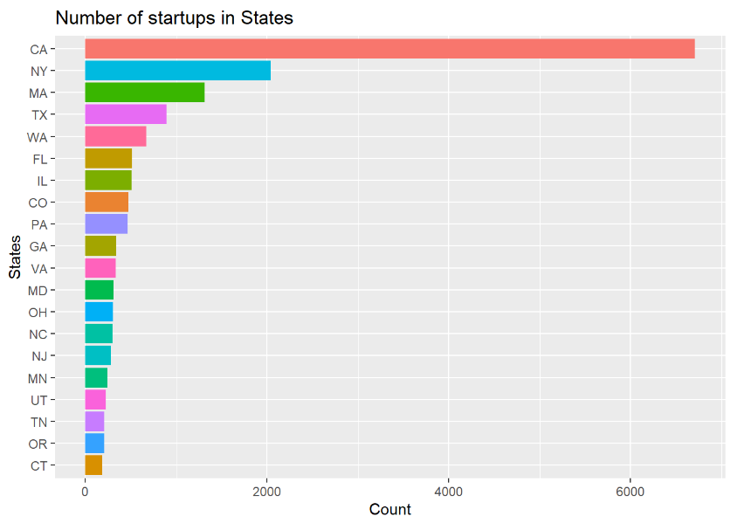

Slide 17
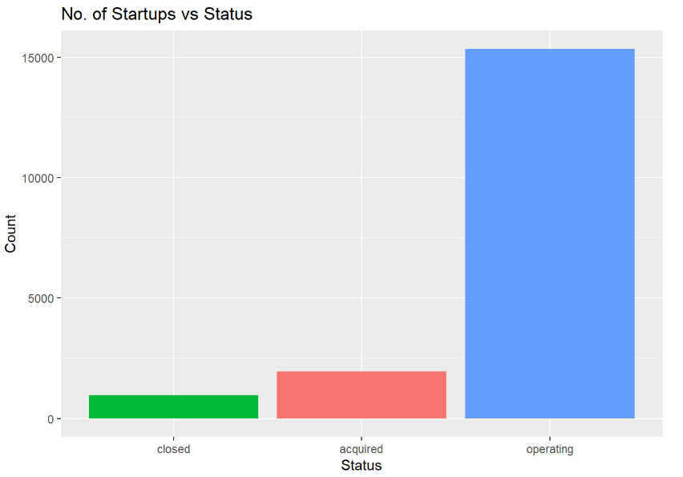

Slide 18


Slide 19
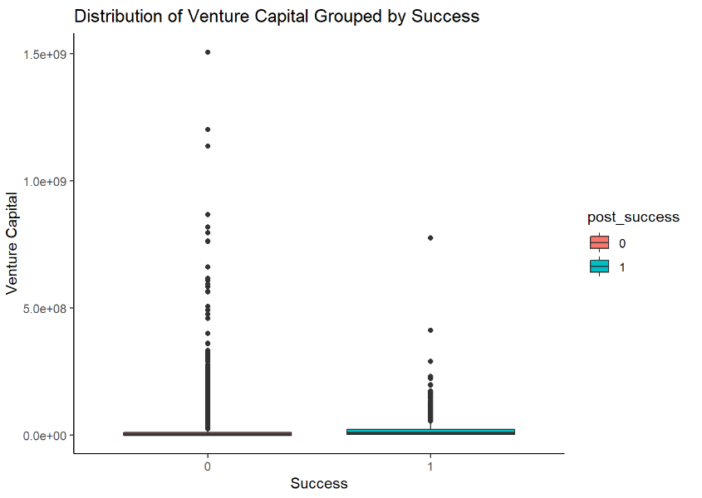

Slide 20
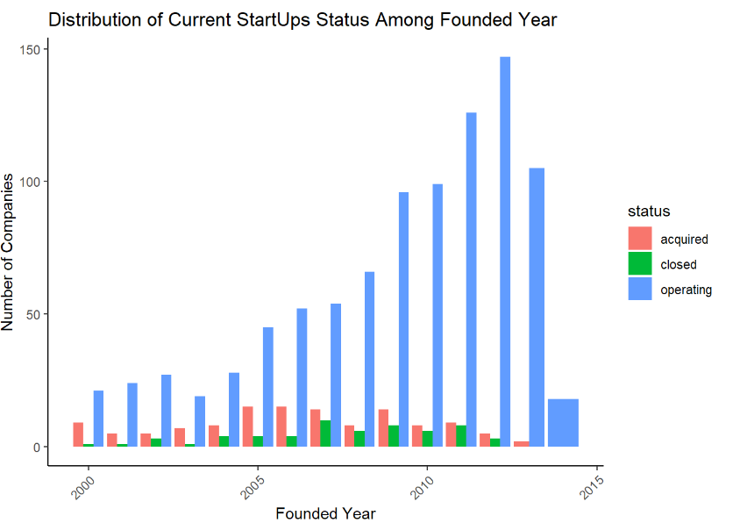

Slide 21
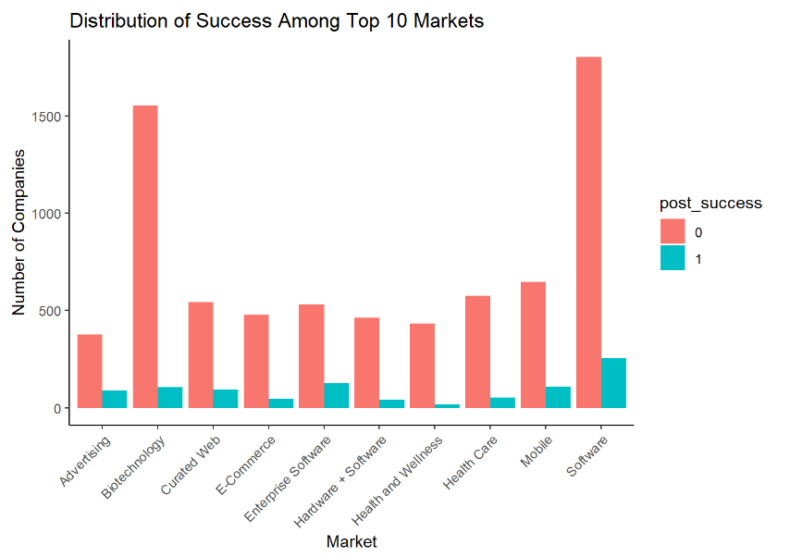

Slide 22
PREDICTIVE MODELS

Slide 23
PREDICTIVE MODELS
 | AUC | F1 | Precision | Kappa | Balanced Accuracy
Logistic Regression | 0.995 | 0.993 | 0.997 | 0.992 | 0.995
Gradient Boosting Machine | 1.000 | 1.000 | 1.000 | 1.000 | 1.000
KNN | 0.532 | 0.126 | 0.489 | 0.107 | 0.532

Slide 24
CONCLUSIONS

Slide 25
CONCLUSIONS
Startups in the field of software, advertising and biotechnology have more success rate when compared to others.
Successful companies are backed by Venture capital. Even top companies like Facebook, YouTube, Google are backed by venture capital in the initial stages.
More number of funding rounds, seed amount, venture capital, post IPO equity contributes to the success of a startup.
More funding in the initial rounds A, B, C can contribute to the success of a startup.
We used 3 algorithms, namely the KNN, logistic regression and the gradient boosting model (GBM) to train 3 different machine learning models. Based, on AUC score we concluded that GBM is the best model.

